Slide 1
Introduction to Machine Learning
Billy McGough
DD Month YEAR

Slide 2
Covered in this presentation
Demystifying Machine Learning
Introducing the different types
Non-engineering example: Recognising Handwriting
AIRBUS Applications of AI
How can I spot future tasks which are appropriate for a Machine Learning solution?
APA
A380 Fuel

Slide 3

What is Machine Learning?
Pattern Spotting!
Perception!
Intelligence!
Whatever you want to call it, machine learning is the science of teaching computers to spot trends in data and predicting future outcomes based on those trends, without explicit instruction.
Notes:
You will see based on this definition that there are some very basic examples that mee

Slide 4
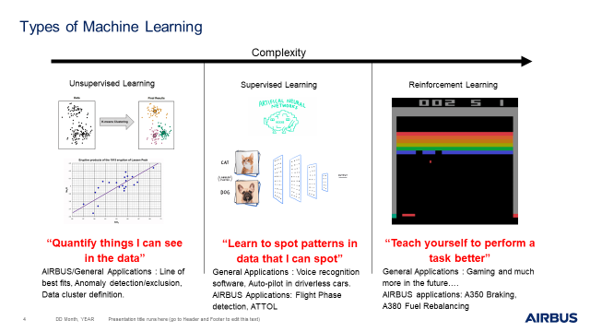

Slide 5
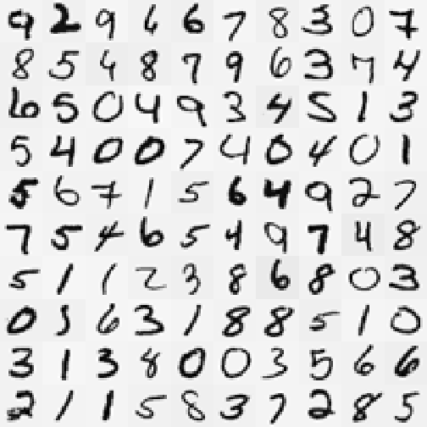
Case Study: Reading Handwriting
We learn to read handwritten text in primary school, irrespective of different styles of handwriting.
How would you try telling a computer what each handwritten number looks like? How would it recognise every possible handwritten digit?

Slide 6
Case Study: Reading Handwriting
In this case study, I will break down how computer can learn to recognise numerical digits, as an example of Machine Learning.
We will use a model called a ‘Neural Network’ – which falls into the supervised learning category. This method forms the basis for most ML applications.
After this example, we take a top-level view of various machine learning projects happening at AIRBUS, deconstructing the theory behind them with the theory learnt in this application.

Slide 7
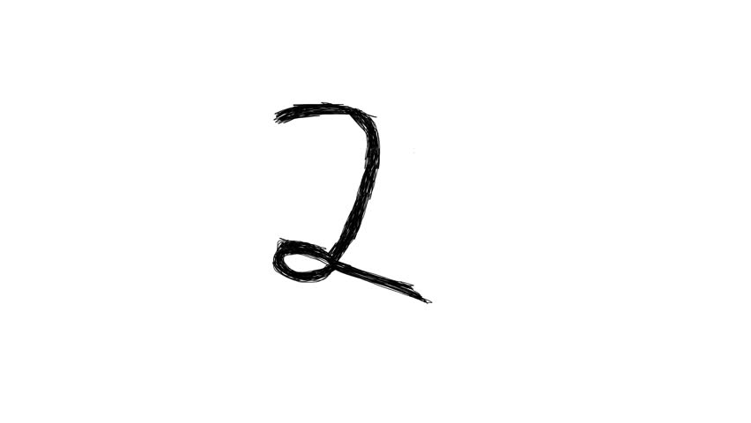
Neural Network
Step 1: Format Incoming Data
Each handwritten example is an image of 40x40 pixels.
Each Pixel has a greyscale value between 0-1.
Therefore, each handwritten letter can be completely characterized by (40x40) 1600 data points between 0-1.
This is the first step of every machine learning problem: Include every single data point the model could possibly need, and process it into the correct format. All we need to do here is flatten the 2D data into a list of numbers between 0-1.
1 | 2 | 3 | 4 | … | … | 1598 | 1599 | 1600
0 | 0.2 | 0.5 | 1 | … | … | 0 | 1 | 0
Notes:
First things first: how do you feed an image as data into anything?

Slide 8
Neural Network
Step 2: Prepare Model Space
Input Layer
Output Layer
Remember, each image of handwritten letters can be completely characterized by (40x40) 1600 data points.
These 1600 points define the Neural Network’s ‘input layer’. This will just be the 1600 greyscale values extracted from the handwritten image
The ‘output layer’ is all the possible outcomes. In this example, that is all the possible numerical digits.
How do these layers interact?
Digit 0
Pixel 0
0
Digit 1
Pixel 1
0.2
Digit 2
Pixel 2
0.5
Digit 3
Pixel 3
1
Digit 4
Digit 5
Digit 6
Pixel 1597
0.8
Digit 7
Pixel 1598
0
Digit 8
Pixel 1599
1
Digit 9
Pixel 1600
0
Notes:
Input layer is exactly equal to the list of pixel greyscale values.
Output layer is equal to a list of all the possible outcomes. In this example, the list details all digits between 0-9.
The input layer decides the output layer, hopefully correctly predicting the image shown in the input data, by selecting ‘1’ on the correct digit and 0 on everything else.

Slide 9
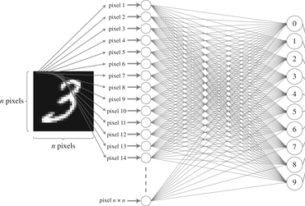
Notes:
This is how the two layers interact
Every pixel fires off its greyscale value to the output layer.
Each output layer digit takes the weighted sum of all the pixels in the previous layer.
So 0 will look at all the pixel values return a number equal to the weighted sum of those values. As will 1,2 etc.
(point to all the connections.)

Slide 10
Neural Network
Step 2: Prepare Model
Activation: weighted sum of the previous layer’s values
What does ‘Weighted Sum’ mean?
Each digit in the output layer will have 1600 unique weights, corresponding to each pixel. The weights are multiplied by the input data and summed to produce an output value. There is a different set of weights and different output value for each digit.
Input Layer
Output Layer
‘Weighted Sum’
Pixel 0
0
2
Digit 0
Pixel 1
0.2
0.5
Digit 1
Pixel 2
0.5
7
Digit 2
0.2
Digit 3
Pixel 3
1
Digit 4
Digit 5
Pixel 1597
0.8
Digit 6
The weights differentiate the answers in the output layer, as all digits see the same greyscale values.
The Neural Network’s answer is the highest weighted sum in the output layer.
Pixel 1598
0
Digit 7
Pixel 1599
1
Digit 8
Pixel 1600
0
Digit 9
Notes:
You feed in the input data and the weights differentiate the answers in the output layer.
Digit 0 will have different weights than digit 1,2 etc. which results in different outputs. The neural network’s answer is the highest output.
This bit is complicated at first but don’t worry. For now, just take away that each digit’s weights dictate the correct answer.

Slide 11
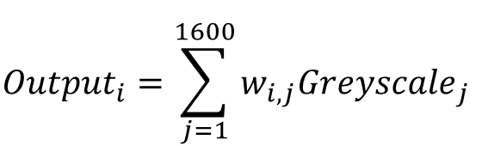

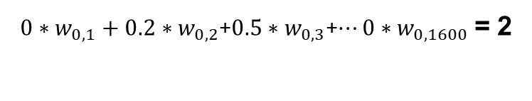
Neural Network
Step 2: Prepare Model
Input Layer
Output Layer
‘Weighted Sum’
Pixel 0
0
2
Digit 0
$${Output}_{i}=\sum_{j=1}^{1600}{w_{i,j}{Greyscale}_{j }}$$
Pixel 1
0.2
0.5
Digit 1
Pixel 2
0.5
7
Digit 2
0.2
Digit 3
Pixel 3
1
Digit 0 Case
Digit 4
$0∗w_{0,1}+0.2∗w_{0,2}$+$0.5∗w_{0,3}$+$…0∗w_{0,1600}$ = 2
Digit 5
Digit 1 Case
Digit 6
Pixel 1597
0.8
$0∗w_{1,1}+0.2∗w_{1,2}$+$0.5∗w_{1,3}$+$…0∗w_{1,1600}\text{= }0.5$
Digit 7
Pixel 1598
0
Pixel 1599
1
Digit 8
Pixel 1600
0
Digit 9

Slide 12
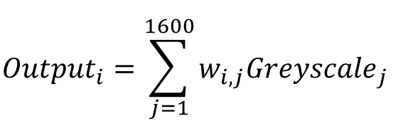
Neural Network
Step 2: Prepare Model Space
$${Output}_{i}=\sum_{j=1}^{1600}{w_{i,j}{Greyscale}_{j }}$$
Input Layer
Output Layer
Pixel 0
0
Digit 0
Pixel 1
0.2
Digit 1
The Neural networks outputs are a function of two variables:
The input data
Each output layer’s weights
The input data is the same for across all digits. To create an accurate, useful neural network you must give it the correct weights!
In this example, a neural network with the rights weights will be able to differentiate between different input images and select the correct corresponding digit for each input image.
To give the neural network the correct weights, give it example images to learn from.
0.5
Digit 2
Pixel 2
Pixel 3
1
Digit 3
Digit 4
Digit 5
Pixel 1597
0.8
Digit 6
Pixel 1598
0
Digit 7
Pixel 1599
Digit 8
1
Pixel 1600
0
Digit 9

Slide 13
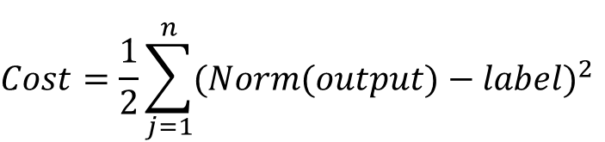

Neural Network
Step 3: Learning!
$$Cost=\frac{1}{2}\sum_{j=1}^{n}{{(Norm(output)−label)}^{2}}$$
Normalised Output
Label
Output Layer
Output
Digit 0
2
0.88
0
Digit 1
0.5
0.622
0
Cost is the sum of the differences between the correct answer and the neural network’s normalised output.
The more wrong a neural network’s output, the higher its cost. The cost is a measure of the neural network’s inaccuracy.
Learning is a cost reduction exercise.
In the example on the right…
Every guess the neural network makes has a corresponding cost, measuring the guess’s accuracy. How do we teach the neural network to estimate correct answers, reducing its cost and getting more accurate results?
Digit 2
1
7
0.999
Digit 3
-0.1
0.475
0
Digit 4
-0.4
0.4
0
Digit 5
0.4
0.36
0
Digit 6
0.12
0.598
0
Digit 7
0.3
0.575
0
Digit 8
1.7
0.84
0
$Cost=\frac{1}{2}({(0.88−0) }^{2}$+${(0.622−0) }^{2}$….
$$Cost=3.5$$
Digit 9
0
0
0

Slide 14
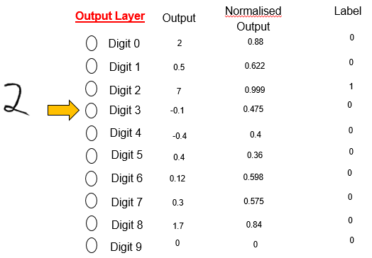

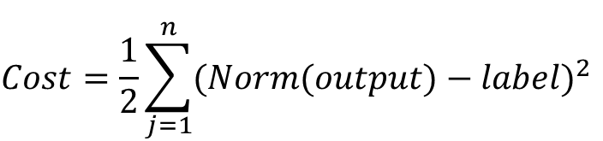
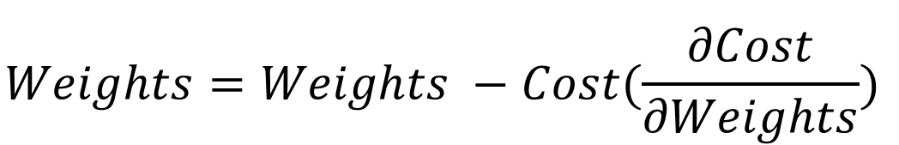
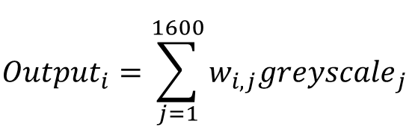
Neural Network
Step 3: Learning!
$$Cost=\frac{1}{2}\sum_{j=1}^{n}{{(Norm(output)−label)}^{2}}$$
$${Output}_{i}=\sum_{j=1}^{1600}{w_{i,j}{greyscale}_{j}}$$
To teach our Neural Network, we find $\frac{∂Cost}{∂Weights}$ and compute this:
$$Weights=Weights −Cost(\frac{∂Cost}{∂Weights})$$
Notes:
To recap: Cost can be described as how inaccurate a neural network is. It is a function of its output and label (ie, correct answer)
The Output has been established as a function of the previous layer’s greyscale values and its own weights. This means that cost is a function of weights! We can change weights! But how do we do this accurately?
With every trained guess, we compute dC/dw and slightly adjust the weights to reduce the cost for the given training example.

Slide 15
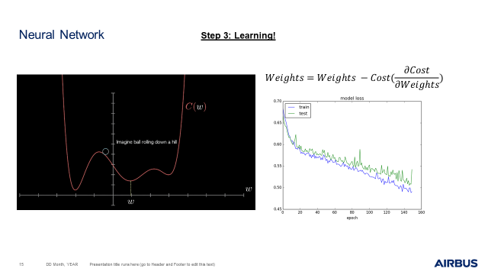

Slide 16
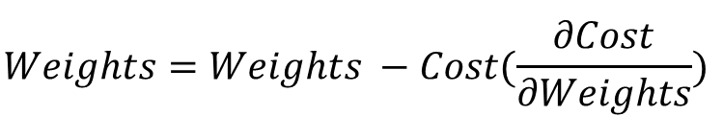
Neural Network
In Summary
$$Weights=Weights −Cost(\frac{∂Cost}{∂Weights})$$
Neural Networks learn using labelled data, such as images of a handwritten number with the corresponding correct output.
By iteratively feeding data into the network and tweaking the network’s weights using mathematically encoded cost-reduction, we can produce a product that can spot patterns in the input data and declare accurate outputs.

Slide 17
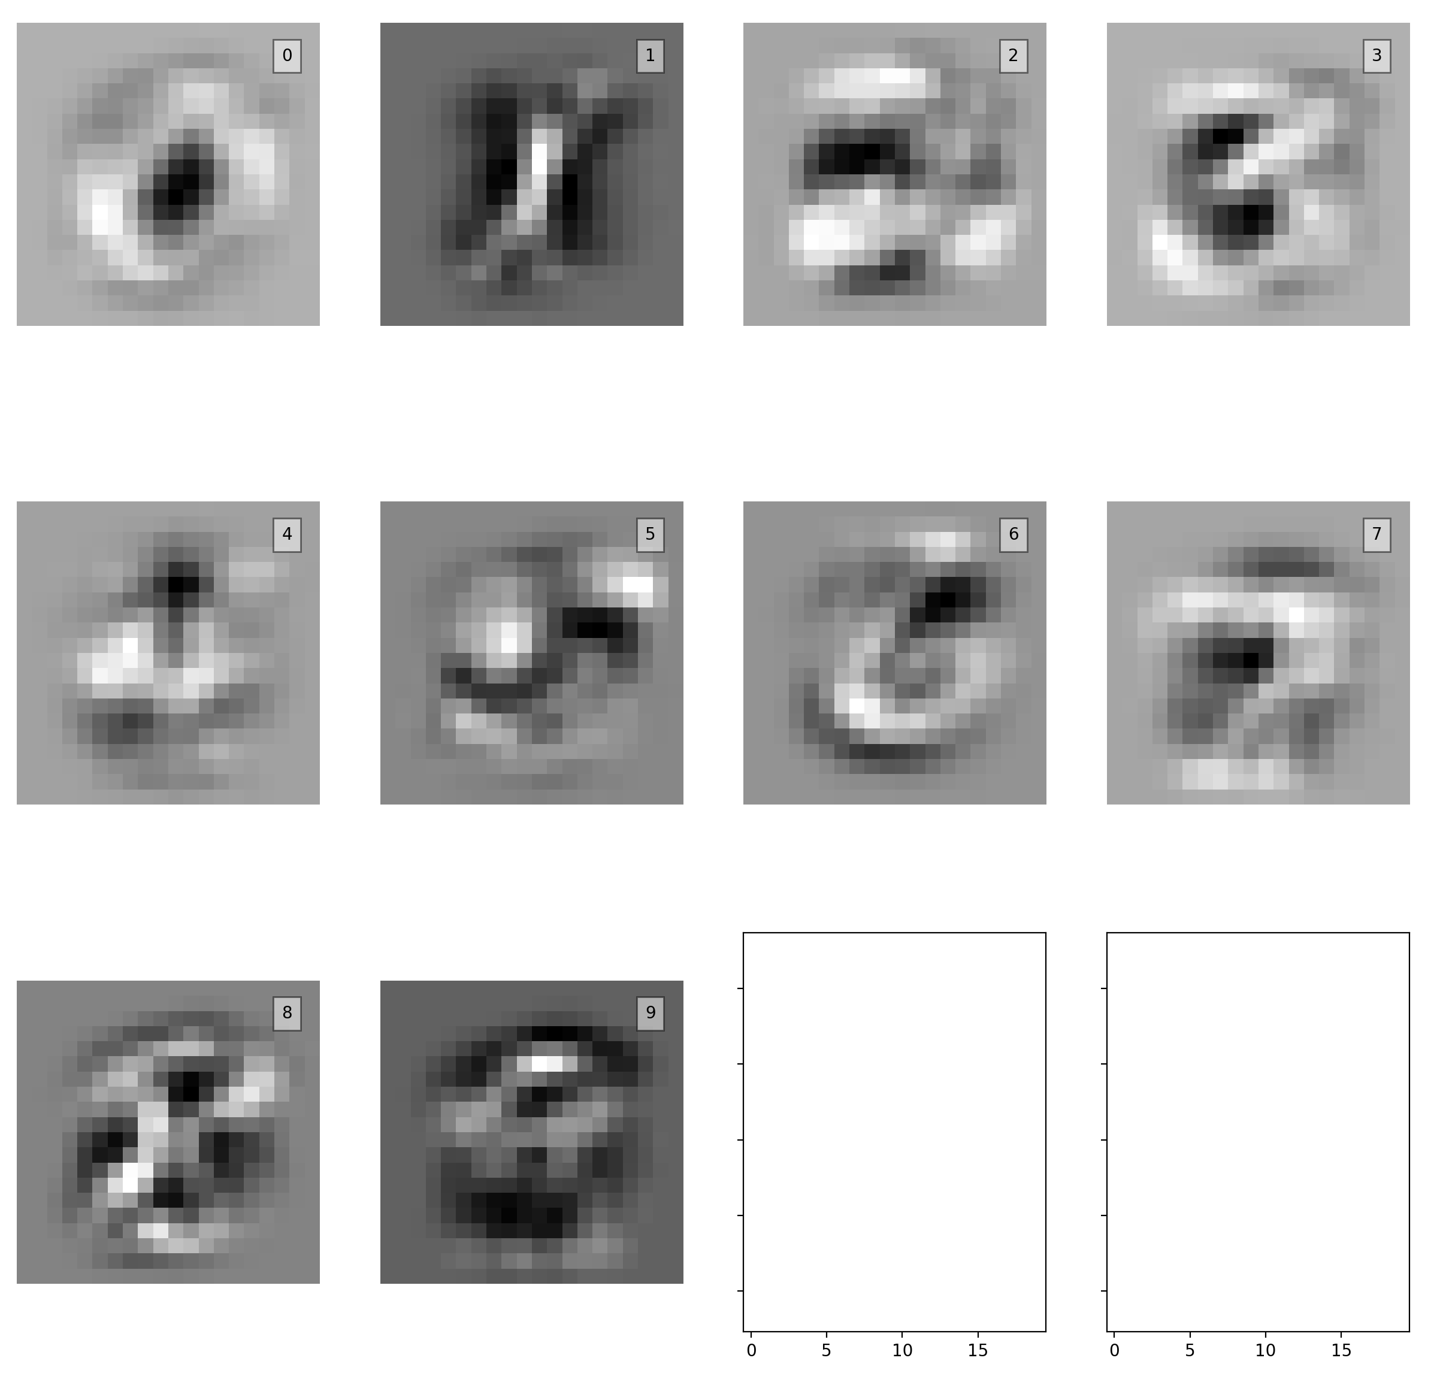
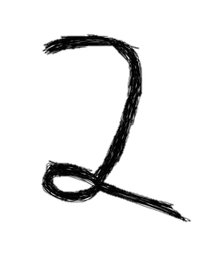
Neural Network
In Summary: Another View
Each output digit has 1600 weights. If you plotted each digit’s weights as an image… what would you get?
WHATS GOING ON??
Notes:
Whats going on ????
You can clearly identify most of the numbers by their weight patterns. Here, it is demonstrated how the neural network ‘sees’ after a significant amount of training! How it has been mathematically optimized to judge digits!
Here you can see that the light pixels are the highest weights and black pixels are the lowest weights. This indicates that for each possible outcome, there are datapoints which matter most to determine that outcome. (point to a central straight line for 1, curves for 8).

Slide 18
Neural Network
Making your own ML solution
Only 4 things are needed to create a ML solution
A Pattern to spot / A target to aim for – This needs your judgment.
Handwritten numbers written on paper are obvious patterns. But other examples include seeing anti skid oscillations in time-series pressure-data, or detecting when an aircraft is off the ground. Have you ever had to find/ monitor data for patterns before? Or improve the performance of a system by tweaking parameters?
Lots of data!!!
In this example, we could clearly identify the number in each handwritten image. This is crucial to learning; if you can learn to spot patterns in data, so can a neural network. Therefore, the provided data should contain everything needed to spot the output/ improve the output.
A Systems expert and a Programmer
You are the system experts, you bring to the table your expertise and judgment. A skilled programmer can take care of the syntax and coding for you, you must provide all your knowledge to fully bound the problem and provide useful insights for the programmer.
Think:
What data will the network need to have to make a correct judgment?
How can I simplify the problem? Based on my expert knowledge, are there clever assumptions that can be made?
What does a correct answer look like? Do you want the solution to predict things for you accurately, or just flag things for you to make a final judgment about? Is this solution going on the aircraft, if not, where is it going?

Slide 19
REDACTED FOR CONFIDENTIALITY

Slide 20
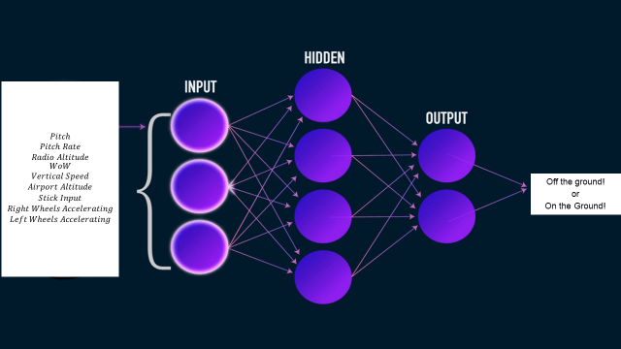

Slide 21
REDACTED FOR CONFIDENTIALITY

Slide 22
REDACTED FOR CONFIDENTIALITY

Slide 23
REDACTED FOR CONFIDENTIALITY

Slide 24
REDACTED FOR CONFIDENTIALITY

Slide 25
But first, like every game, let’s propose a cheat code… Genetic Algorithm
This algorithm develops great solutions to gaming problems. However, it can be extremely computationally heavy, so it can’t be used live in-game, as games are generally fast-paced.
This algorithm relies on a competent reward function. This is where your engineering judgment comes into play; how do you judge better performance? In the snake example, do you just wish to reward the longest snake length achieved? Or also duration of time alive? Least possible actions to achieve snake length?
This is how the algorithm works, using the extremely simple snake example:
Given an initial state (starting location of snake, and of food), try all the possible actions (up, down, left, right)
Using a model of your environment (Snake game), evaluate the next state following all of your different actions
Using a Reward Function, rank the different actions
… (In more complicated examples, a survival of the fittest tournament takes place here)
Use the initial state as an input and highest ranked action as a label to teach a neural network!
The genetic algorithm generates very good answers for you, like a cheat code!
A neural network will learn to play snake based on the answers the genetic algorithm feeds it!

Slide 26
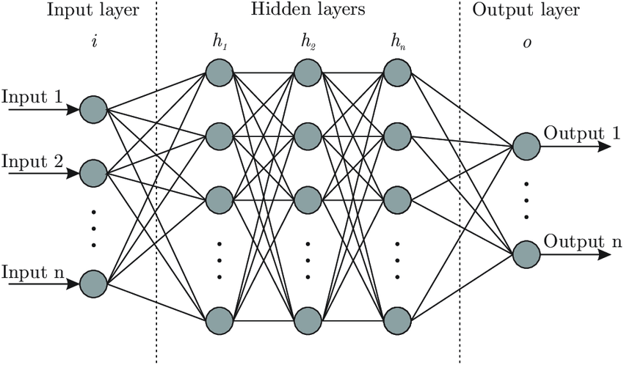
Reward Function
Rewards action that reward good Snake game-playing
Genetic Algorithm
Best action selected
Environment
State Generator
State
State
Action/Label

Slide 27
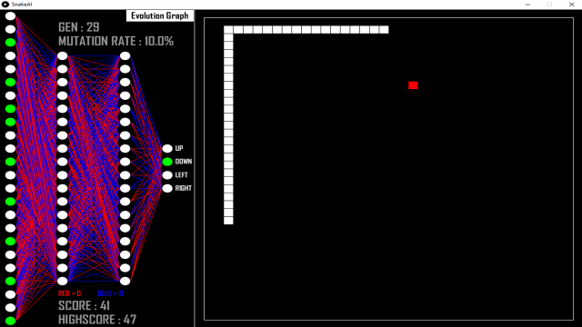

Slide 28
Thank you

Slide 29
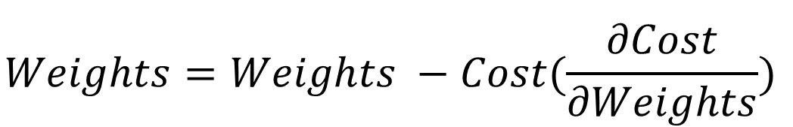
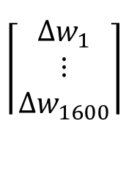
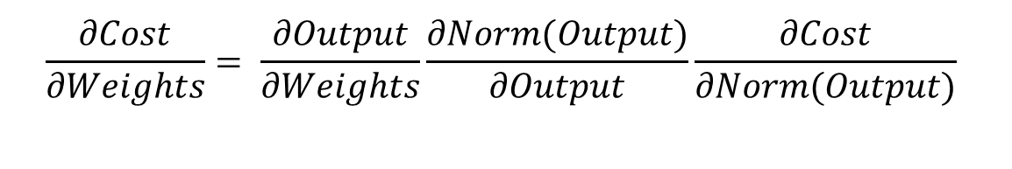
For questions about Maths…
You apply this equation to each output digit to improve its weights:
$$Weights=Weights −Cost(\frac{∂Cost}{∂Weights})$$
$$\left\lceil \begin{matrix}{Δw}_{1} \\ ⋮ \\ {Δw}_{1600}\end{matrix}\right\rceil$$
$$\frac{∂Cost}{∂Weights}= \frac{∂Output}{∂Weights}\frac{∂Norm(Output)}{∂Output}\frac{∂Cost}{∂Norm(Output)}$$
Notes:
MENTION WE ARE LOOKING AT ADJUSTMENTS FOR ONE OUTPUT DIGIT – DIGIT 0

Slide 30
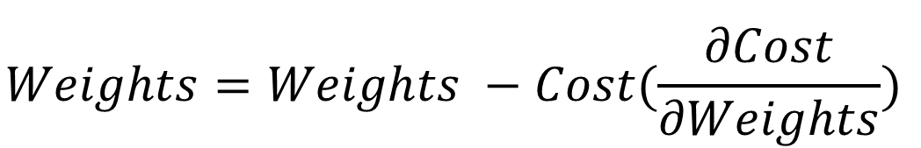
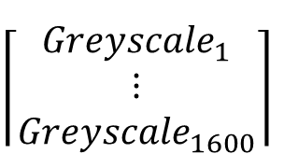
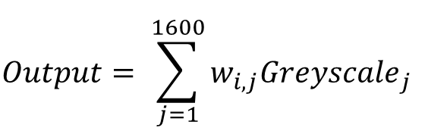
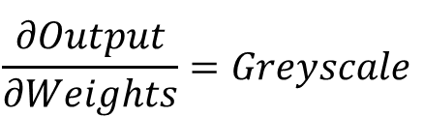
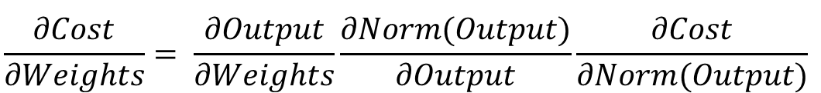
For questions about Maths…
$$Weights=Weights −Cost(\frac{∂Cost}{∂Weights})$$
$$\frac{∂Cost}{∂Weights}= \frac{∂Output}{∂Weights}\frac{∂Norm(Output)}{∂Output}\frac{∂Cost}{∂Norm(Output)}$$
$$Output= \sum_{j=1}^{1600}{w_{i,j}{Greyscale}_{j }}$$
$$\left\lceil \begin{matrix}{Greyscale}_{1} \\ ⋮ \\ {Greyscale}_{1600}\end{matrix}\right\rceil$$
$$\frac{∂Output}{∂Weights}=Greyscale$$

Slide 31
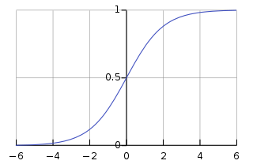
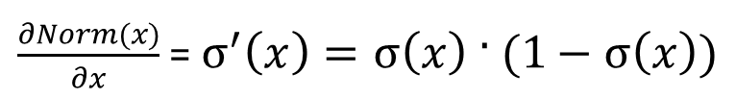


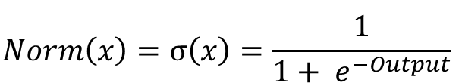
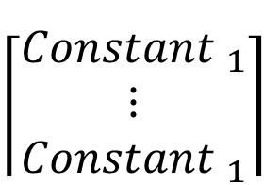

For questions about Maths…
$$Weights=Weights −Cost(\frac{∂Cost}{∂Weights})$$
$$\frac{∂Cost}{∂Weights}= \frac{∂Output}{∂Weights}\frac{∂Norm(Output)}{∂Output}\frac{∂Cost}{∂Norm(Output)}$$
$$\left\lceil \begin{matrix}{Greyscale}_{1} \\ ⋮ \\ {Greyscale}_{1600}\end{matrix}\right\rceil$$
$$x= Output$$
$$Norm\left(x\right)=σ\left(x\right)=\frac{1}{1+ e^{−Output}}$$
$\frac{∂Norm(x)}{∂x}$ = $σ^{′}\left(x\right)=σ\left(x\right) · (1−σ\left(x\right))$
$$\left\lceil \begin{matrix}{Constant }_{1} \\ ⋮ \\ {Constant }_{1}\end{matrix}\right\rceil$$
$$σ\left(x\right) · \left(1−σ\left(x\right)\right)={Constant }_{1}$$

Slide 32
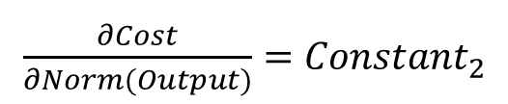

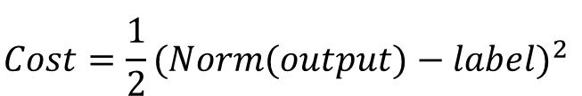
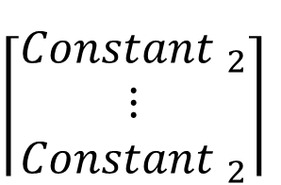
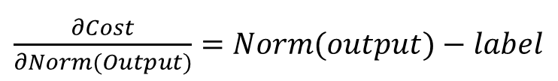
For questions about Maths…
$$Weights=Weights −Cost(\frac{∂Cost}{∂Weights})$$
$$\frac{∂Cost}{∂Weights}= \frac{∂Output}{∂Weights}\frac{∂Norm(Output)}{∂Output}\frac{∂Cost}{∂Norm(Output)}$$
$$\left\lceil \begin{matrix}{Greyscale}_{1} \\ ⋮ \\ {Greyscale}_{1600}\end{matrix}\right\rceil$$
$$\left\lceil \begin{matrix}{Constant }_{1} \\ ⋮ \\ {Constant }_{1}\end{matrix}\right\rceil$$
$$Cost=\frac{1}{2}{(Norm(output)−label)}^{2}$$
$\frac{∂Cost}{∂Norm(Output)}=$ $Norm(output)−label$
$$\left\lceil \begin{matrix}{Constant }_{2} \\ ⋮ \\ {Constant }_{2}\end{matrix}\right\rceil$$
$\frac{∂Cost}{∂Norm(Output)}=$ ${Constant}_{2}$

Slide 33
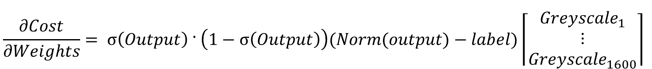
For questions about Maths…
$$Weights=Weights −Cost(\frac{∂Cost}{∂Weights})$$
$$\frac{∂Cost}{∂Weights}= \frac{∂Output}{∂Weights}\frac{∂Norm(Output)}{∂Output}\frac{∂Cost}{∂Norm(Output)}$$
$$\frac{∂Cost}{∂Weights}= σ\left(Output\right) · \left(1−σ\left(Output\right)\right)(Norm(output)−label)\left\lceil \begin{matrix}{Greyscale}_{1} \\ ⋮ \\ {Greyscale}_{1600}\end{matrix}\right\rceil$$

